Slide 1
Cloud Robotics Sprint 3
Olivia Monteiro, Alicia Reed, Danny Steuer, Archer Taylor, Eli Weber
Team Website
Team Github
Team ReadtheDocs

Slide 2
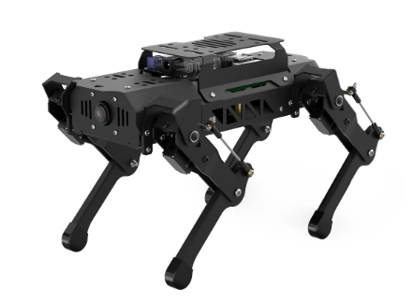
Project Focus
Provide a client-server architecture to develop educational systems to support STEM interest in K-12 students​
Use voice control to activate and control the PuppyPi

Slide 3
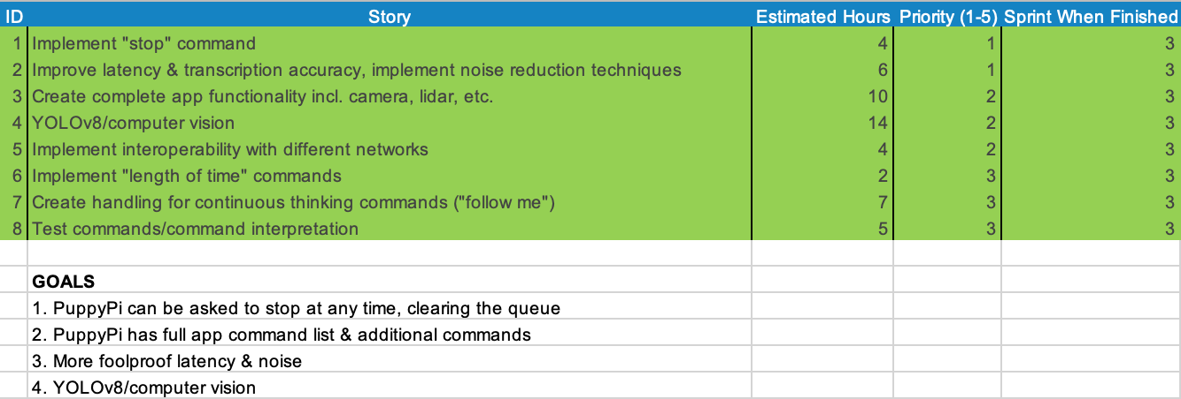
Sprint Backlog

Slide 4
Project Functionality
PuppyPi responds to 40+ commands, 9 of which are intelligent modes created by our team
Automatic network connection, wake word, setup script & more
New features this sprint: face detection, color detection, line following, lidar, apriltag detection
Audio compression & noise reduction implemented

Slide 5
Reflection & Further Work
Overall a complete effort from our team; we finished all except one of our goals
We have created a secure, ready-to-use product that fits our sponsor’s requests
Sponsor very happy with resulting product
Further work includes computer vision, gesture recognition, using the attachable arm, & more - detailed in our documentation

Slide 6
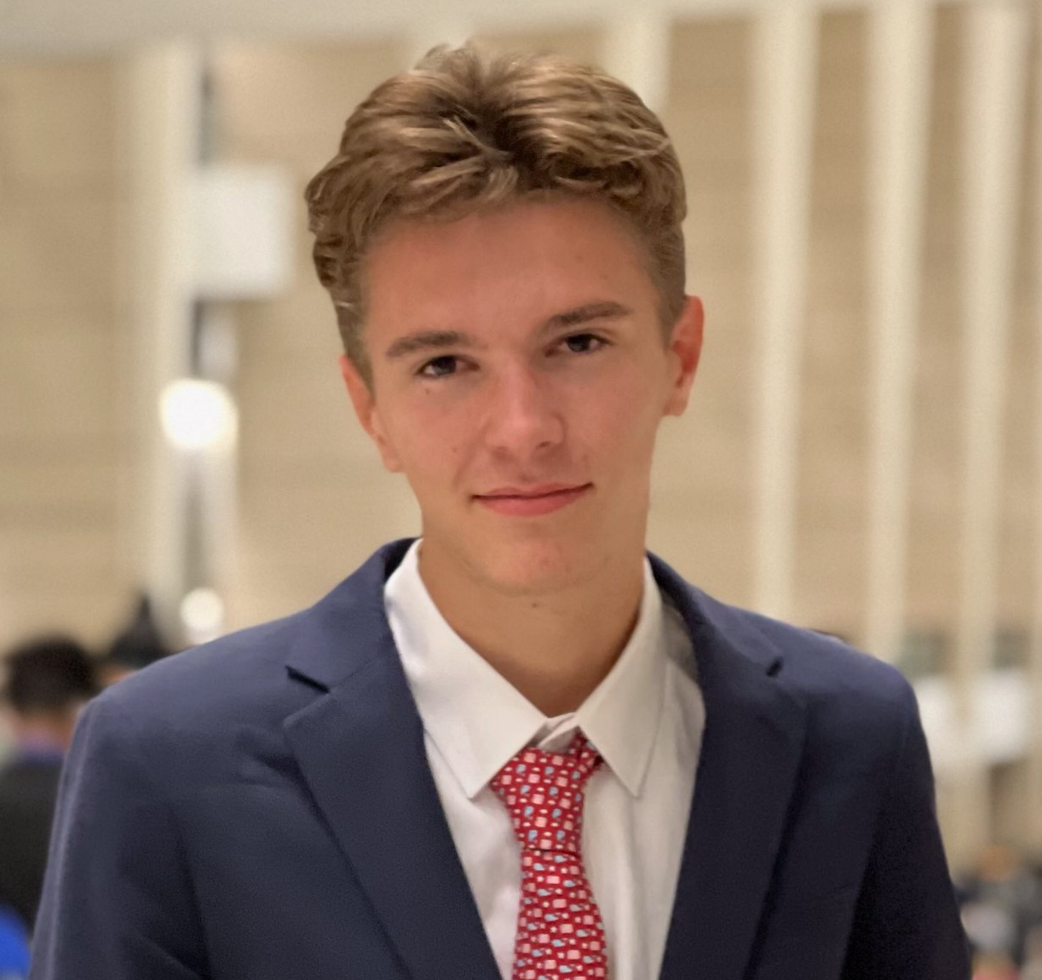
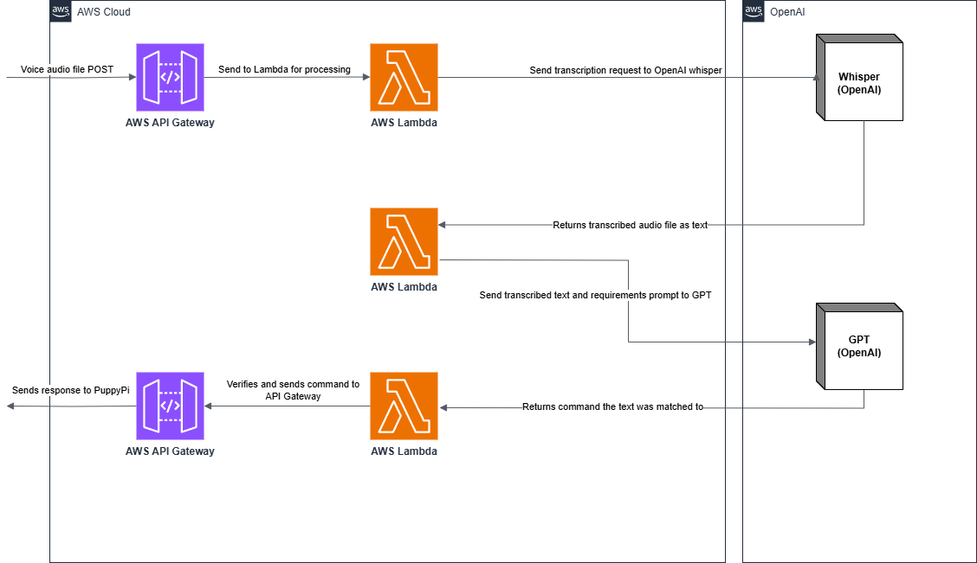
Individual Contributions
Archer Taylor Cloud architecture, system integration, device automation, AI & Voice comprehension systems

Slide 7
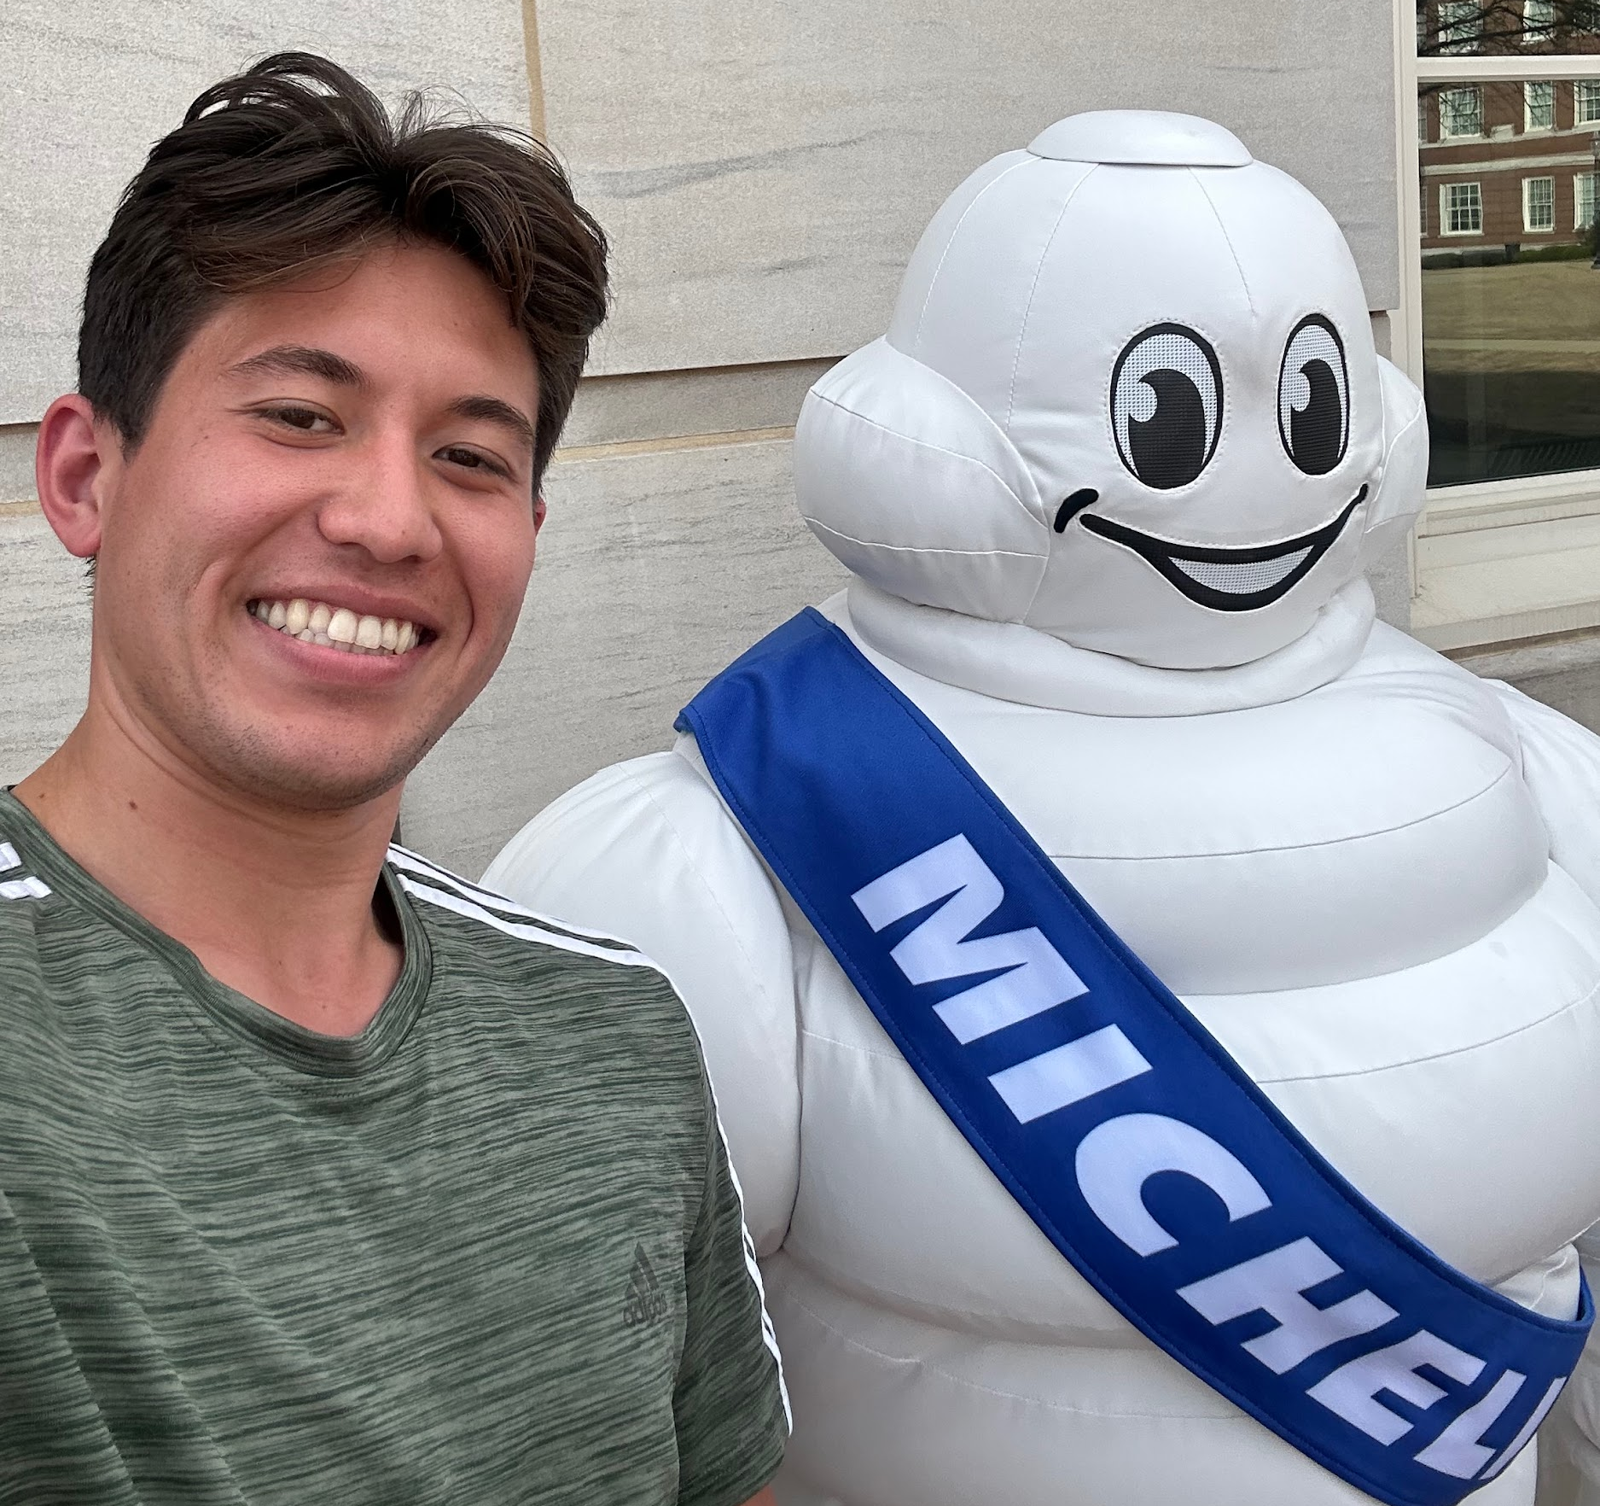
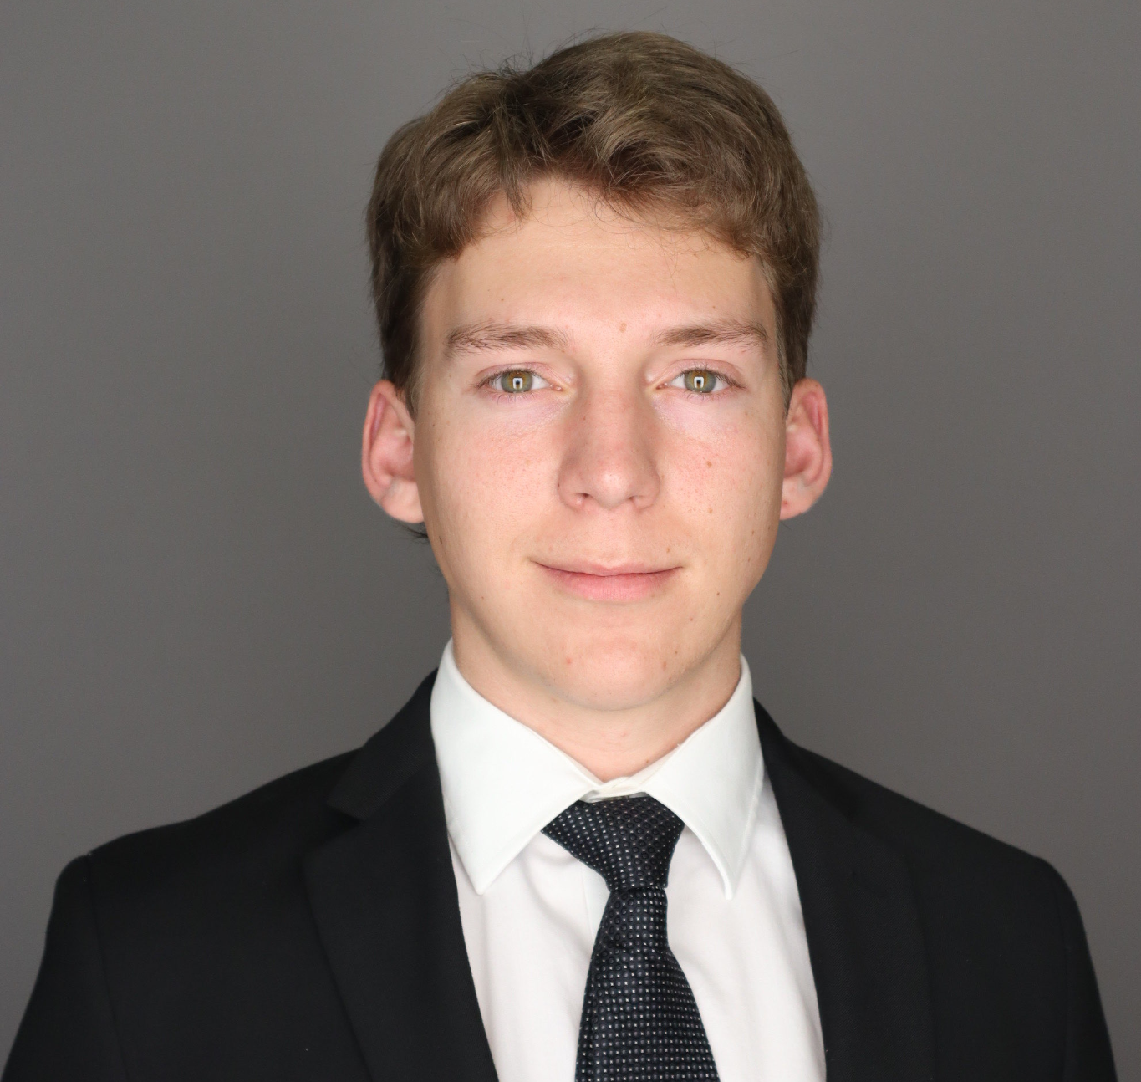
Individual Contributions
Danny Steuer
Wake word, Stop command, walking for a user-determined amount of time, multiple commands
Eli Weber
Duration commands: walking, turning
Action Interruption

Slide 8
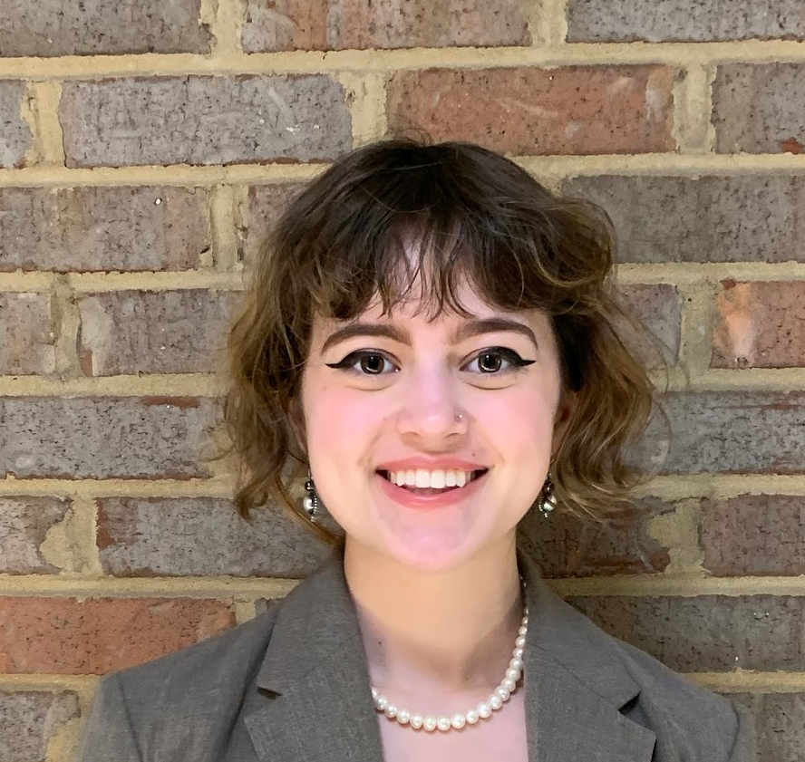
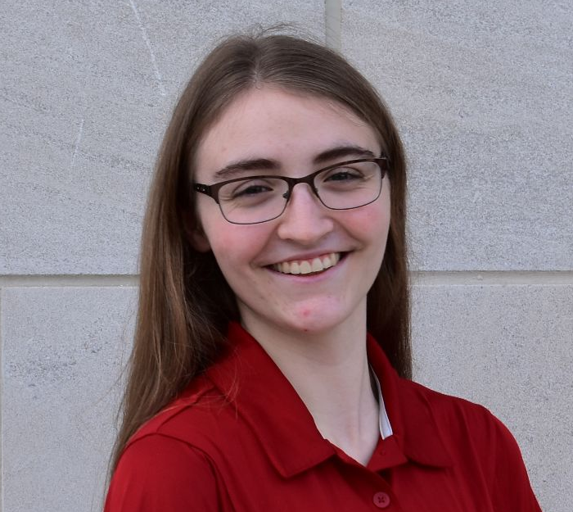
Individual Contributions
Olivia Monteiro
Documentation, walking & turning, face detection, line following, apriltag detection & lidar
Alicia Reed PuppyPi app research, color detection

Slide 9
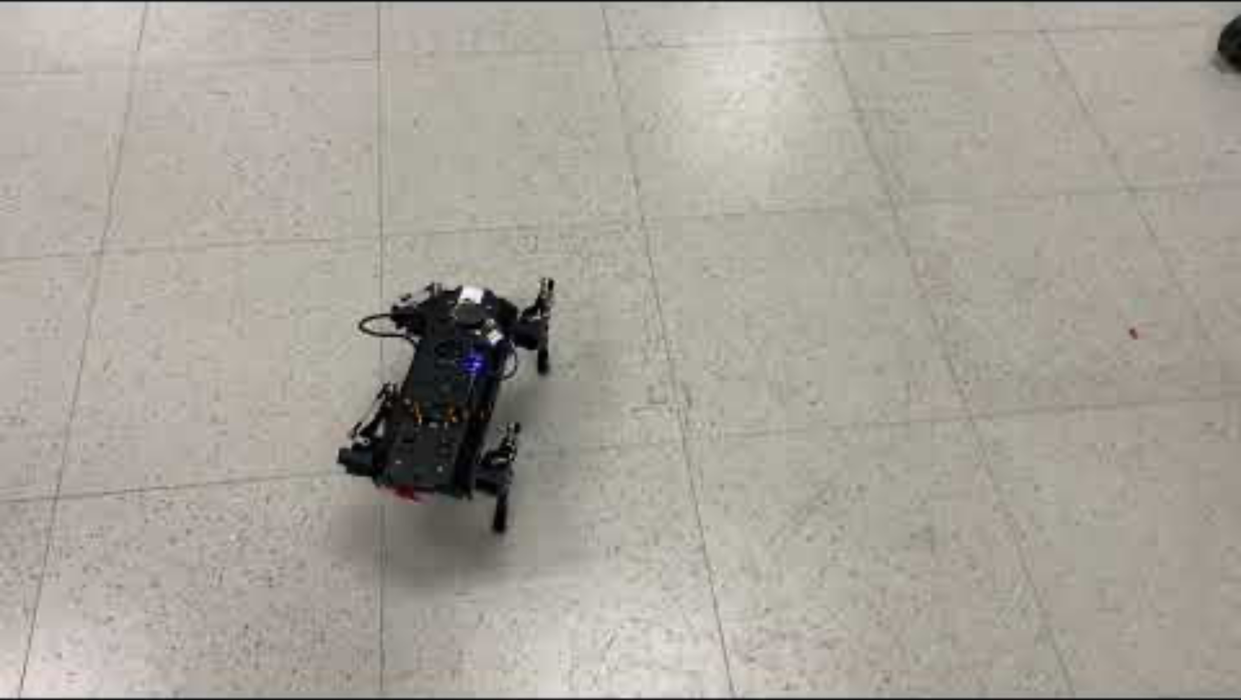
Notes:
https://youtu.be/n4dVPrf9L7o

Slide 10
Thanks!
Any questions?

